Slide 1
Econ 106: Data Analyis for Economics Lecture 7
slides adapted from: https://r4ds.had.co.nz/tidy-data.html

Slide 2
Reminders
Lab 2 is due Sunday, 11:59pm
https://pollev.com/vsovero
Notes:
In brief, we’ll
1. Introduce the R programming language and the RStudio interface
2. Discuss how operators and functions work
3. Investigate the structure of data frames

Slide 3
#tidytuesday
Fun fact: ggplot has a geom_moon (someone please use it for your project!)
Code is here

Slide 4
Outline for Today
cleaning quantitative variables:
removing non-numeric values
separate into multiple columns
converting to date time objects

Slide 5
Variable Type
Things you should decide about a variable:
Categorical: values can be non-numeric, have a fixed and known set of possible values
Quantitative: values are numeric, represent an order and a quantity
This can be different from how the data is stored in R:
numeric
character
factor

Slide 6
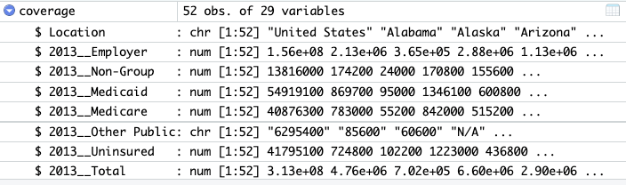
Cleaning Quantitative Variables
Problem: there are character variables that should be numeric (quantitative)
https://pollev.com/vsovero

Slide 7
Converting Vector Type
as.numeric(): your values should be numbers
as.character(): your values can be numbers or characters
factor(): your values are categorical (finite set of values)

Slide 8
Converting Vector Type (Coercion)
Sometimes R has to change the values of a vector to accommodate the new type
Sometimes the value cannot be accommodated, so it gets set to missing (NA)
Example: "badger" is not numeric, gets erased (NA)
Original Vector | As character | As numeric
x <- TRUE | "TRUE" | 1
y <-35 | "35" | 35
z <- "badger" | "badger" | NA
Notes:
We’ve said that vectors can only hold one data type.
So what happens if you try to make a vector with multiple data types?
R looks at the data elements as a whole and finds a data type that can accommodate all of the elements
Ways to accommodate anything include making everything into a character or reading logical values as 0 and 1

Slide 9
Coercion
We coerce a variable to numeric when it has some non-numeric values
You will get a warning from R telling you that non-numeric values are being set to missing
This is fine when the values didn’t contain any useable information

Slide 10
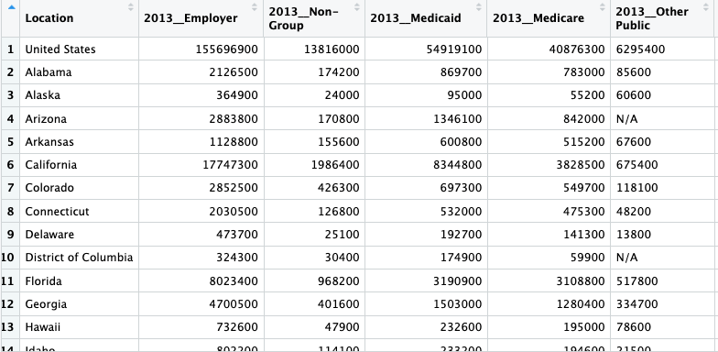
Check your data
Let’s take a look at the data and see which values are non-numeric
We can see that “N/A” is the culprit
This is an example where coercion would not removing valid data

Slide 11
Side Note: Variable Names
In this data set, variables are named in a way that breaks some of our naming rules:
shouldn’t start with a number
shouldn’t have spaces
shouldn’t have special characters

Slide 12
Side Note: Variable Names
When the variable names “break the rules”, we have to include backticks to reference them in our code
large_uninsured_states<- coverage %>%
filter (Location!= "United States") %>%
filter (`2016__Uninsured`>=1000000)

Slide 13
Coverage Example
We use mutate() to create new variables
the new variable names are listed in purple
note that we are recycling the original names and just converting vector type
coverage_coerce <- coverage %>%
mutate(`2016__Other Public`=as.numeric(`2016__Other Public`),
`2015__Other Public`=as.numeric(`2015__Other Public`),
`2014__Other Public`=as.numeric(`2014__Other Public`),
`2013__Other Public`=as.numeric(`2013__Other Public`))

Slide 14
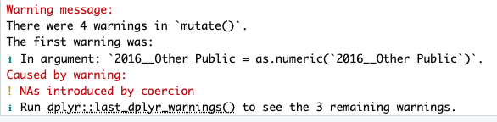
Coverage Example
coverage_coerce <- coverage %>%
mutate(`2016__Other Public`=as.numeric(`2016__Other Public`),
`2015__Other Public`=as.numeric(`2015__Other Public`),
`2014__Other Public`=as.numeric(`2014__Other Public`),
`2013__Other Public`=as.numeric(`2013__Other Public`))
When there is coercion (values are being converted to NA), you will get a warning message in the console

Slide 15
Exercise
examine the end_year variable in the transit_cost data frame. Why is it stored as character?
convert end_year to numeric

Slide 16

When coercion goes wrong
There are instances where you convert a variable to numeric and end up wiping out valid data
the case rate in the table below is a character, but should be numeric (quantitative)

Slide 17
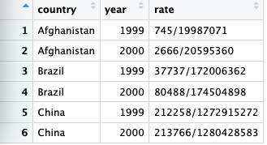
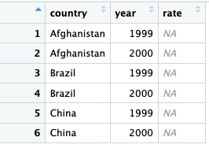
When coercion goes wrong
table3_coercion <- table3 %>%
mutate(rate=as.numeric(rate))

Slide 18
Splitting values into multiple columns
In table3, the rate variable needs to be split into two columns

Slide 19
Separate()
Arguments
col: The name of the existing variable whose values you want to split
into: The name of new variables where the split values will be moved into
sep: The string used to identify where to make the split
convert: whether you want the new variables to be converted to numeric
table3_separated <- table3%>%
separate(col=rate,
into = c("cases", "population"),
sep = "/”,
convert=TRUE)

Slide 20
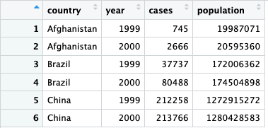
Separate()
table3_separated <- table3%>%
separate(col=rate,
into = c("cases", "population"),
sep = "/",
convert=TRUE)

Slide 21
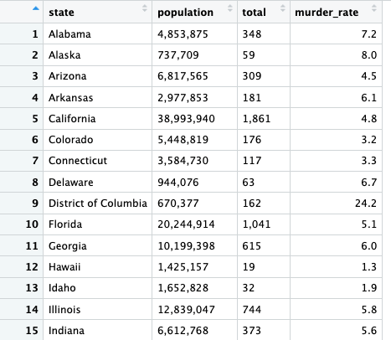
A Trickier Example
Population is a quantitative variable, but the commas are making R read it as character
How do we remove the commas?

Slide 22
String Processing
The values in a character variable are referred to as strings
One of the most common data wrangling challenges involves extracting numeric data contained in character strings and converting them into numeric

Slide 23
String processing
String processing tasks can involve:
pattern detection
extraction based on a pattern
replacement based on a pattern

Slide 24
Murders Data
What’s the pattern?
There are commas in the population values

Slide 25
Murders Data
What do I want to do based on the pattern?
Remove the commas in the population values, leave everything else

Slide 26
str_replace_all()
murders_clean<-murders_raw%>%
mutate(new_population=str_replace_all(population,",", ""))
Arguments for str_replace_all():
the variable that contains strings: population
the pattern to look for: a comma
the replacement value: nothing

Slide 27
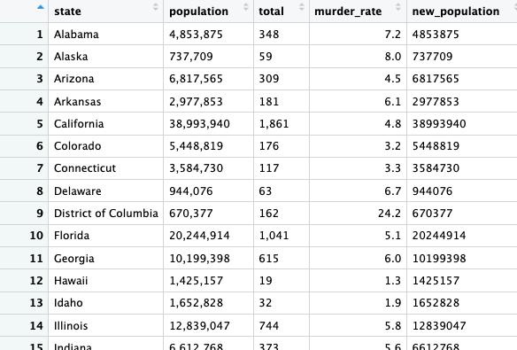
str_replace_all()
murders_clean<-murders_raw%>%
mutate(new_population=str_replace_all(population,",", ""))

Slide 28
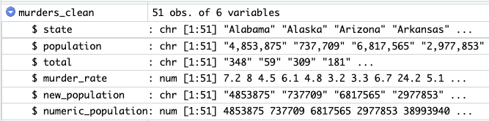
But wait, it’s still not numeric
We use as.numeric() to convert it
murders_clean<-murders_raw%>%
mutate(new_population=str_replace_all(population,",", ""), numeric_population=as.numeric(new_population))

Slide 29
Exercise
Examine the tunnel_per variable in the transit_cost data frame. Why is it stored as character?
Convert it to numeric.
https://pollev.com/vsovero

Slide 30
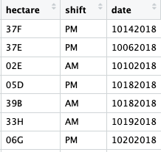
Working with Dates and Times
Dates and times are a type of quantitative variable
This date variable is currently stored as numeric, but it is better to convert it to a date object

Slide 31
Working with Dates and Times
Things you can do with date objects:
extract year, month, day
calculate time spans

Slide 32
Functions to create a Date Object
Depending on how your date is ordered, select the appropriate function to create a date object:
ymd("2017-01-31")
mdy("January 31st, 2017")
dmy("31-Jan-2017")
You can also create a date-time object:
ymd_hms("2017-01-31 20:11:59")
mdy_hm("01/31/2017 08:01")

Slide 33
Converting to Dates
We will use the mdy() function, which comes from the lubridate package inside the tidyverse
Arguments: the variable you want to convert to a date object
Output: a variable that is a date type
squirrels_date<-nyc_squirrels%>%
mutate(date_converted=mdy(date))

Slide 34
Converting to Dates
squirrels_date<-nyc_squirrels%>%
mutate(date_converted=mdy(date))

Slide 35
Pulling out components from a Date
Once you have a date or date object, you can pull out individual parts of the date, such as:
year()
month()
mday() : day of the month
yday(): day of the year
wday(): day of the week
For date-times, you can additionally pull out:
hour()
minute()
second()

Slide 36
Pulling out components from a Date
Arguments:
the date variable you want to pull information from(date_converted)
label: whether you want the new variable to be numeric or factor
squirrel_month<-squirrel_date%>%
mutate(month_factor=month(date_converted, label=TRUE),
month_num=month(date_converted, label=FALSE))

Slide 37
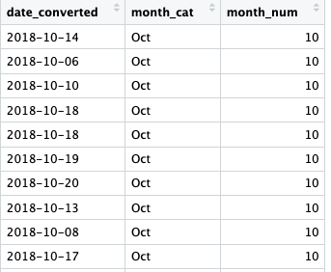
Pulling out components from a Date
squirrel_month<-squirrel_date%>%
mutate(month_factor=month(date_converted, label=TRUE),
month_num=month(date_converted, label=FALSE))
https://pollev.com/vsovero

Slide 38
Exercise
Pull out day of the week as a factor variable
count the number of squirrel sightings by day of the week, filled by time of day (shift)

